Slide 1


Slide 2
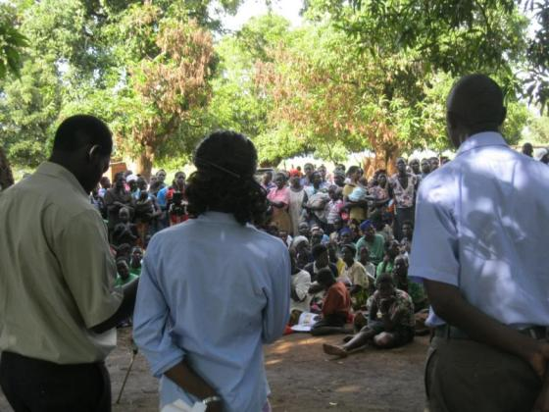
Our Motto
Working for justice and reconciliation with grassroots communities
JRP staff during the community launch of the Lukodi massacre report (May 2011)

Slide 3
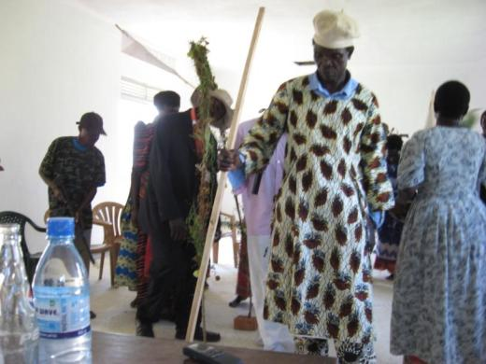
Our Mission
To empower conflict-affected communities to participate in processes of justice, healing and reconciliation
Community theatre in Mukura depicting the desire for traditional reconciliation (August 2011)

Slide 4
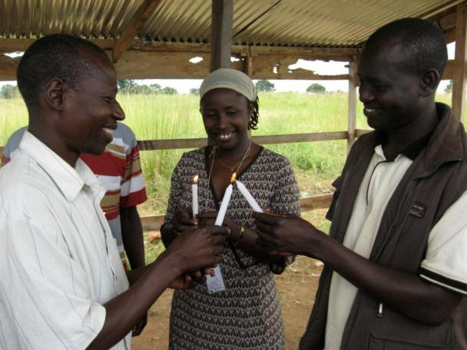
Our Vision
Envisioning a just and peaceful society
Lighting candles during a trust-building exercise with survivors in Mucwini (2010)

Slide 5
Our Objectives
To preserve memory of conflict-affected communities through documentation
To advocate for locally sensitive approaches to transitional justice
To mobilize communities to engage in processes for redress, reconciliation and healing
To support vulnerable groups and individuals in their pursuit of justice

Slide 6
Our Context
Since 1986, Uganda has suffered from 28 armed rebellions.
The longest and bloodiest of these was waged by the Lord’s Resistance Army (LRA) and the Government of Uganda.
The current peace within northern Uganda marks a real opportunity to address the need for national and local reconciliation.
The Juba Peace Agreement, while unsigned, commits the Government to implementing a range of transitional justice mechanisms.

Slide 7



Our History
JRP was founded in 2005 by the Gulu District NGO Forum and the Liu Institute for Global Issues at the University of British Columbia in Canada.
JRP became an independent Ugandan NGO in January 2010 with support from the Norwegian Embassy in Kampala.

Slide 8
Our Approach
We regard community-led transitional justice processes as critical elements in post-conflict justice and reconciliation.
We focus in the following areas:
  Community Mobilization
  Community Documentation
  Gender Justice
  Transitional Justice Policy

Slide 9
Community Mobilization
We engage communities in the identification of ‘what needs to be done?’ to promote justice and reconciliation.
We provide information and updates on transitional justice processes.
We build capacity and generate opportunities for victim involvement in such processes.

Slide 10
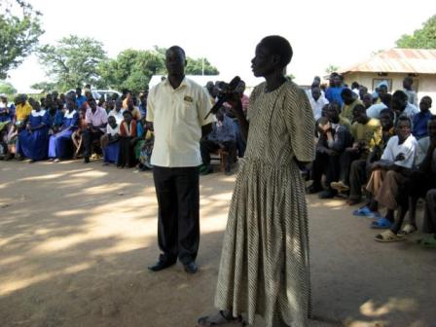
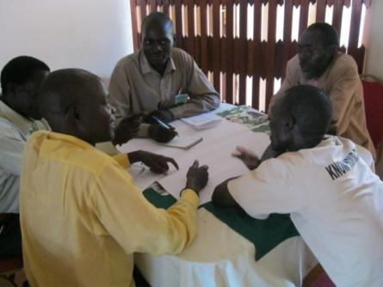
Community Mobilization
Community dialogue in Abia (July 2010)
Survivor advocacy training workshop (September 2010)

Slide 11
Community Documentation
We document conflict-related experiences and memories of individuals, communities and victims’ groups:
  To preserve memory
  To acknowledge loss
  To promote reconciliation and healing
We also support community-led documentation efforts.

Slide 12
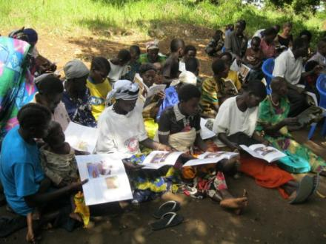
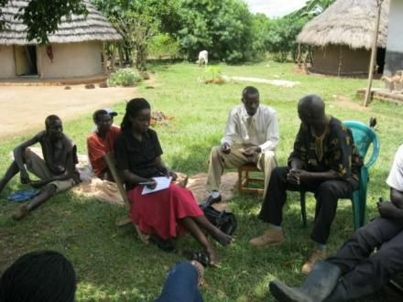
Community Documentation
Lukodi community report launch (May 2011)
Recording survivors’ experiences in Mukura (September 2010)

Slide 13
Gender Justice
We empower formerly-abducted and conflict-affected women to contribute to bridging the gender gap through:
  An advocacy platform where gender concerns in TJ can be deliberated and discussed
  Story-telling
  Legal counseling support (coming in 2012)

Slide 14
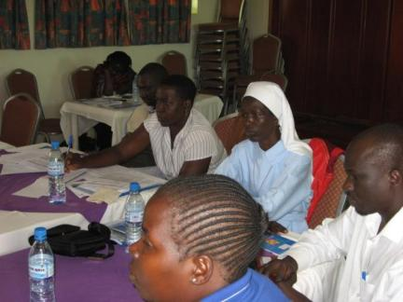
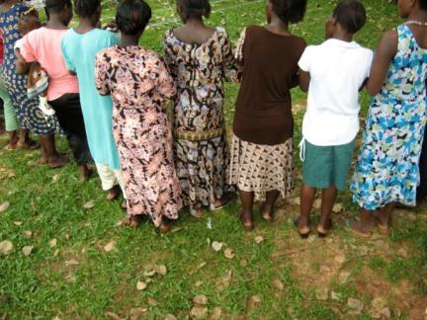
Gender Justice
CSO workshop on gender justice (September 2011)
Women’s theatre day (November 2010)

Slide 15
Transitional Justice Policy
Through in-depth research and advocacy on emerging TJ issues, we inform national and international-level policy debates.
Through proactive engagement of policy-makers and other stakeholders, we ensure that policy outcomes are locally-sensitive and appropriate to the needs and aspiration of victims.

Slide 16
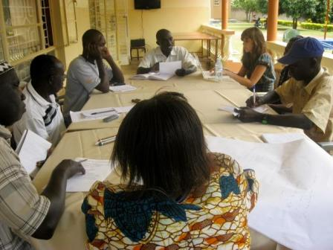
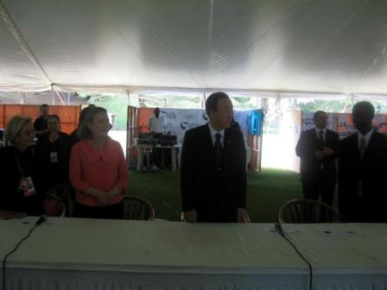
Transitional Justice Policy
Victim consultation in West Nile (November 2010)
UN Secretary General Ban Ki-Moon in front of the JRP table at the ICC Review Conference (June 2010)

Slide 17
Our Publications
Since the beginning, we have prided ourselves on producing high-quality, timely publications. The following are examples:
Flagship report
  Roco Wat I Acholi: Traditional Approaches to Justice and Reintegration (September 2005)
Reports
  We Can’t Be Sure Who Killed Us: Memory and Memorialization in Post-conflict Northern Uganda (February 2011)
  The Cooling of Hearts: Community Truth-telling in Acholi-land (July 2007)

Slide 18
Our Publications
Field Notes
  The Lukodi Massacre: 19th May 2004 (April 2011)
  The Mukura Massacre of 1989 (May 2011)
  Others: Attiak, Barlonyo, Omot, Mucwini
  Alice’s Story: Cultural and Spiritual Dimensions of Reconciliation in Northern Uganda (February 2006)
Newsletters
  Quarterly Updates from JRP
  Community Voices

Slide 19
Our Publications
Statements and Briefs
  Policy briefs on truth-seeking, gender justice, reparations and traditional justice (August 2011)
  Pursuing Justice for Women and Children (July 2010)
  Moving Forward: Thomas Kwoyelo and the Quest for Justice (November 2011)
All of our publications are available for download at www.justiceandreconciliation.com

Slide 20
Our Contacts
JRP’s offices are located in Senior Quarters, Gulu town, northern Uganda.
For more information on our work, please contact:
  Justice and Reconciliation Project (JRP)
  Plot 50 Lower Churchill Drive, Laroo Division
  P.O. Box 1216
  Gulu, Uganda, East Africa
Tel: +256 (0)471433008
Email: info@justiceandreconciliation.com
Web: www.justiceandreconciliation.com

Slide 21

Apwoyo! Thank you!

